Slide 1

MarketBridge Solutions
IDEATION

Slide 2

CONTENT
01
04
Problem Statement
Competition Analysis
02
05
Solution Overview
Business Model
03
06
Marketing Strategy
Financials

Slide 3


Problem Statement
Small and medium-sized enterprises (SMEs) often struggle to effectively acquire new customers, understand their competitive landscape, and expand into new markets due to limited resources and expertise. There is a need for an integrated platform that combines customer acquisition strategies, real-time competitive analysis, and market expansion tools tailored specifically for MSME.

Slide 4

Solution Overview
GET TO KNOW IT BETTER
This platform should leverage data-driven insights and AI-powered analytics to help businesses identify and target potential customers, monitor and analyze competitor activities, and uncover new market opportunities. The solution should provide actionable recommendations and support business owners in implementing these strategies, ultimately driving growth and increasing market share.

Slide 5

Marketing Strategy
ABOUT OUR TARGET
Target customer
B2B (Business-to-Business).
B2C (Business-to-Customer)
Market Size
10,000,000 SMEs × ₹50,000
= ₹500 billion (or ₹50,000 crores) annually

Slide 6


B2B
1. Geographical Territories- Initial focus on urban and metropolitan areas
2. Priority Industries: Focus on high-growth sectors with customized solutions
3. Content Marketing: LinkedIn and industry-specific forums and hosting webinars and seminars, email campaigns.
4. Strategic Alliances: Partner with industry associations, chambers of commerce, CEOs, marketing directors, and business development managers
Marketing Strategy
B2C
Marketing Strategy
1. Geographical Territories: Metropolitan areas with a high concentration of tech-savvy consumers
2. Target Segments: Focus on consumers who are entrepreneurs, freelancers, or small business owners
3. Personalized messaging: Resonate with the challenges faced by small business owners and entrepreneurs.
4. Social Media Marketing
5. Search Engine Marketing

Slide 7


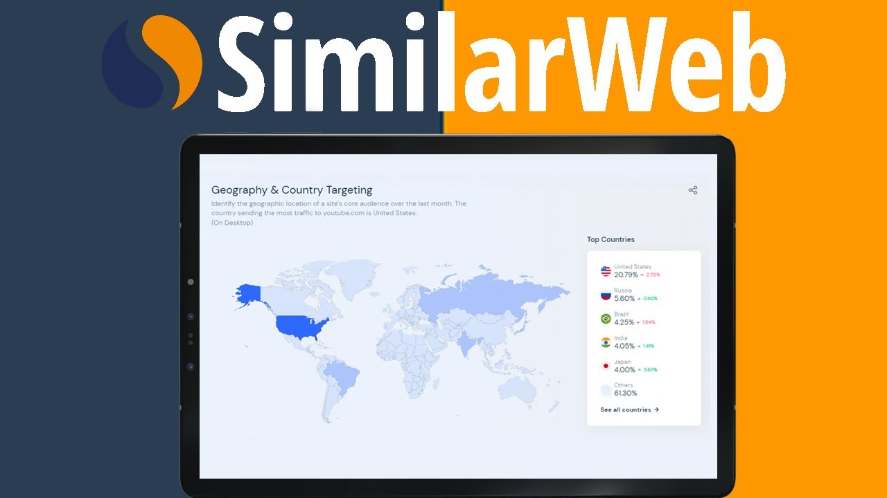
COMPETITION ANALYSIS
HubSpot
Salesforce
SimilarWeb
does not primarily focus on market expansion.
Integrated market expansion services.
doesn’t provide direct tools for customer acquisition.
not be an exact competitor that combines all the elements of customer acquisition, competitive analysis, and market expansion into a single, integrated platform specifically for SMEs,

Slide 8
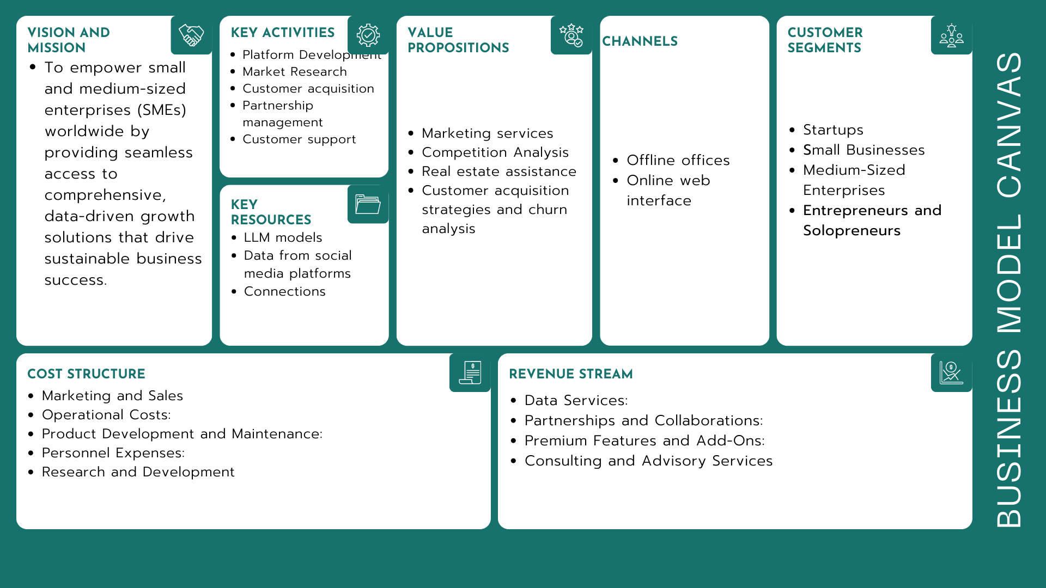
01
Lack of Brand Visibility
Many businesses struggle with gaining visibility in a saturated market. Our solution involves a comprehensive analysis of your brand, audience, and competitors, leading to the development of a strategic branding.
02
Ineffective Digital Presence
03
Lack of Targeted Lead Generation
Weak online presence can hinder business growth. Our agency offers an integrated approach to digital marketing, covering SEO optimization, social media management, content marketing, and more.
Many businesses struggle with generating quality leads that convert into customers. Our solution involves a meticulous understanding of your target audience, allowing us to develop highly targeted lead generation campaigns.

Slide 9
FINANCIALS
10 | INFLOW |  | YR1 | YR2 | YR3 | YR4 | YR5
 | 1 | Revenue | 7 | 15 | 25 | 40 | 60
 | 2 | Expected Funding | 10 | 5 | 0 | 0 | 0
 |  | TOTAL | 17 | 20 | 25 | 40 | 60
2 | OUTFLOW |  | YR1 | YR2 | YR3 | YR4 | YR5
 | RECURRING
 | 1 | Product Development & Maintenance | 5 | 6 | 7 | 8 | 9
 | 2 | Marketing & Sales | 2.5 | 3.5 | 4.5 | 6 | 7.5
 | 3 | Personnel Costs | 3.5 | 4 | 5 | 6 | 7
 | 4 | Customer Support and other | 2.5 | 3 | 4 | 4.5 | 5.5
 |  | TOTAL | 8.5 | 10.5 | 13.5 | 16.5 | 20
3 | OUTFLOW |  | YR1 | YR2 | YR3 | YR4 | YR5
 | ONE TIME
 | 1 | Initial Product Development | 4 | 0 | 0 | 0 | 0
 | 2 | Launch Marketing | 2.5 | 0 | 0 | 0 | 0
 | 3 | Hardware/Infrastructure Setup | 4 | 0 | 0 | 0 | 0
 | 4 | Others | 2 | 0 | 0 | 0 | 0
 |  | TOTAL | 12.5 | 0 | 0 | 0 | 0

Slide 10
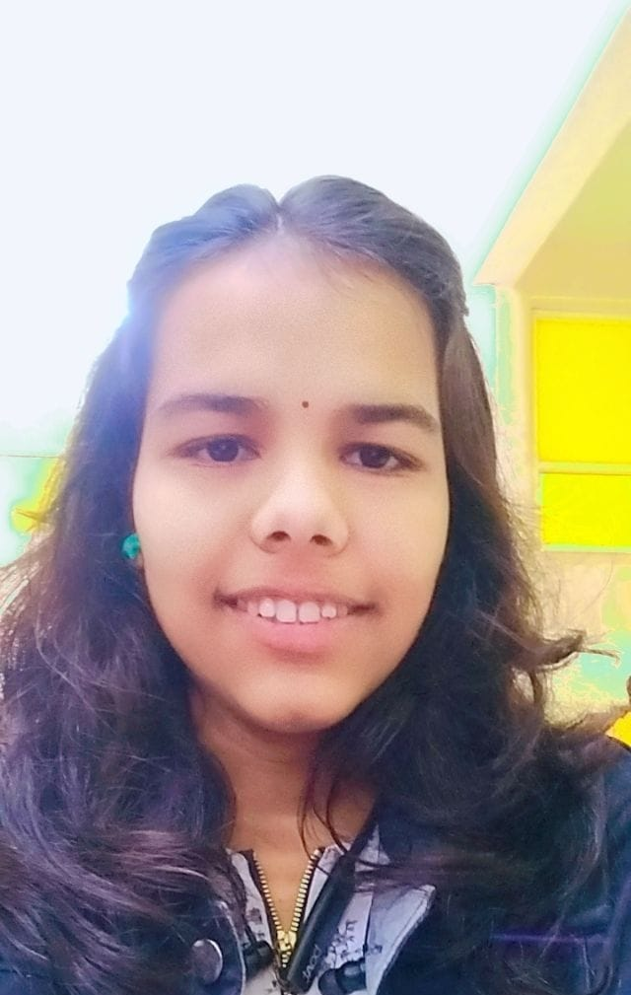
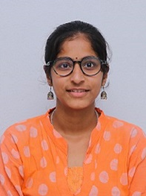
TEAM
Madhura Ghatage
Laxmi Wandare

Slide 11
THANK YOU
FOR YOUR NICE ATTENTION

